Slide 1

Investment Report of: ASTROSAGE.
LOKESH SHARMA

Slide 2

Introduction and Objectives
AstroSage, a leading platform offering astrology consultations, has made significant investments in expanding its consultation services. This includes both chat sessions and call consultations where users can interact directly with expert astrologers (Gurus). As demand for astrology services grows, AstroSage is focused on optimizing the overall user experience and service efficiency, especially in how consultations are delivered.
The Goal:
The primary objective of this analysis is to provide actionable insights that will help AstroSage streamline its consultation services. Specifically, the analysis aims to:
Enhance operational efficiency:
Improve customer satisfaction
:Optimize astrologer (Guru) efficiency

Slide 3

Objectives-:
The project focuses on analyzing key performance indicators (KPIs) that affect consultation service efficiency, customer satisfaction, and astrologer productivity. These KPIs will be analyzed across several dimensions to meet the following objectives:
KPI
Analyze Chat and Call Session Data:
Performance Metrics.
Guru Productivity.
Identify Inefficiencies in Chat Handling, Call Durations.
Chat Duration Analysis.
Call Handling.
Recommend Strategies to Optimize Session Quality and Profitability.
Free vs. Paid Consultations.
Astrologer Training.
Customer Feedback Loop.

Slide 4
Data visualization-:
Dataset Summary:
The dataset provides comprehensive records of chat and call sessions between users and astrologers (gurus) on AstroSage.
Key columns include:
User and Guru IDs: Identifies unique users and astrologers for session tracking.
Chat and Call Durations: Captures the length of each session in seconds.
Session Statuses: Shows if the session was completed, failed, or incomplete.
Consultation Types: Differentiates between chat and call consultations.
Refund Statuses: Indicates whether a session was eligible for a refund or not.
Ratings: Represents user satisfaction after the session.
The dataset covers a wide range of consultations, including free chats, paid calls, and both completed and incomplete sessions.
Data Cleaning:
Standardized timestamps (creation, update, chat start, and end times) to ensure consistency in session tracking
Importance of This Data:
The dataset is essential for understanding customer satisfaction, session quality, and operational efficiency.
By analyzing session durations, refunds, and ratings, we can identify which factors most influence customer retention and guru performance.
The insights gained from this data will guide strategic decisions for investment allocation, improving consultation quality, and driving profitability.

Slide 5

Data cleaning tools-:
Methodology
Steps Taken:
Data Cleaning: Removed null and incomplete records, and standardized time formats.
Session Analysis: Studied chat and call durations, chat status, and refund trends.
Customer Satisfaction: Analyzed the correlation between session durations and user ratings.
Tools Used:
Excel functions like, Pivot Tables, Avg. function, Count Function and trend charts to derive insights.

Slide 6
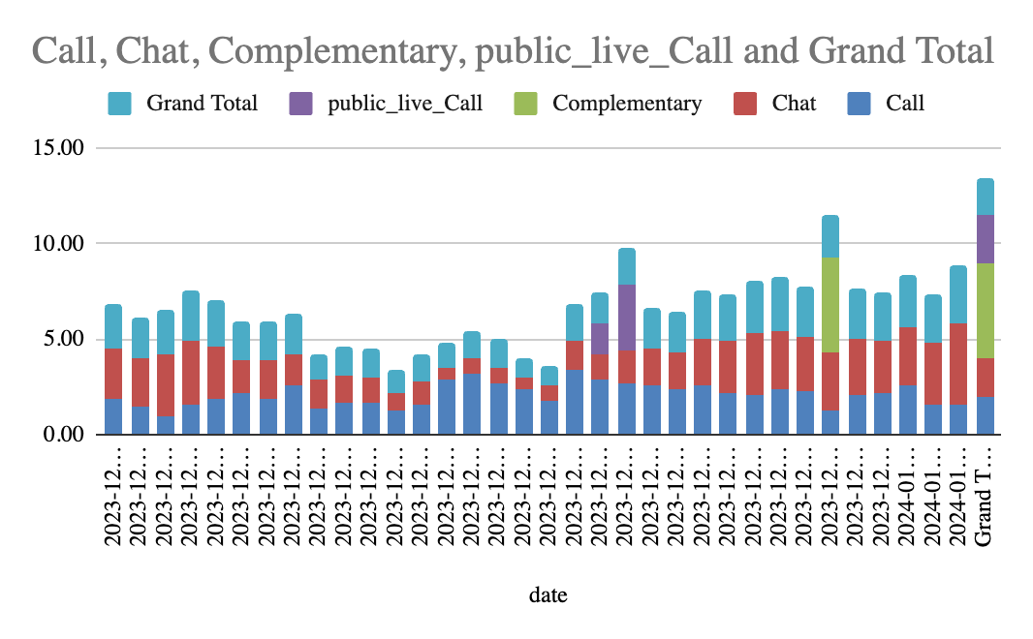
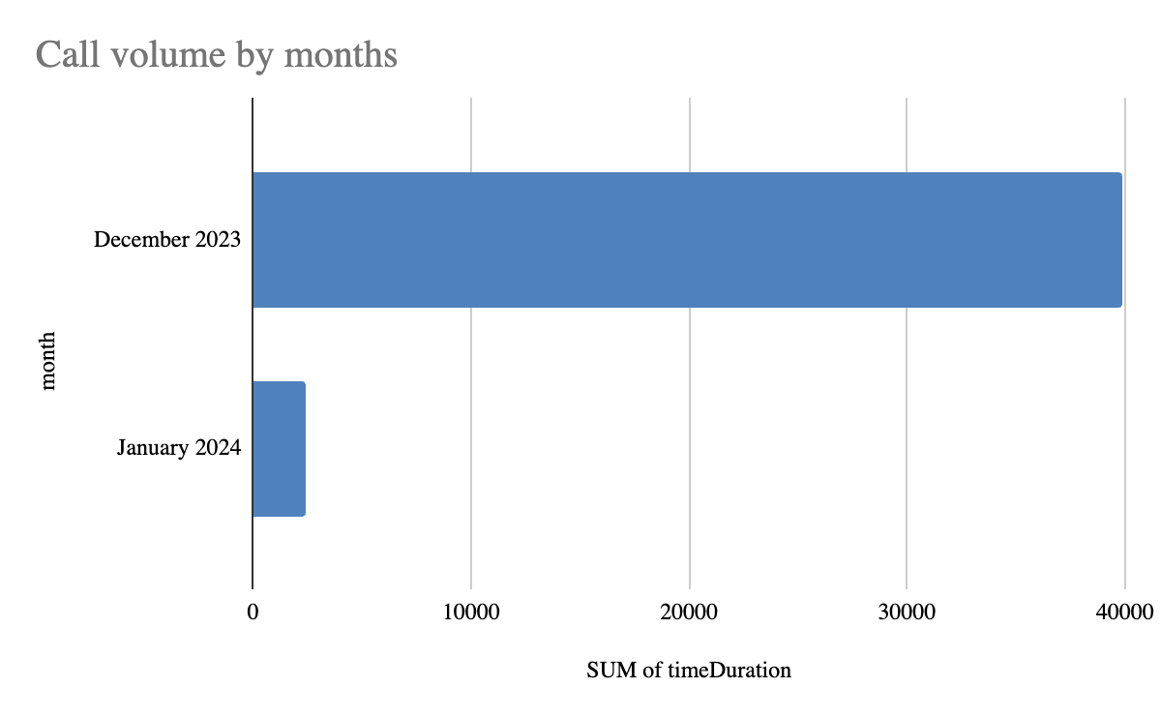
Call Volume and Operational Insights-:
Key Metric:
Average Daily Call Volume: 3.93
Average Change in Call Volume (Day-by-Day): 4.9%
December 2023: 39,886 call duration seconds (Highest)
January 2024: 2,420 call duration seconds (Lowest)
Operational Cost-: December 2023: ₹108,428.46 (Highest)
January 2024: ₹6,412.28 (Lowest)

Slide 7
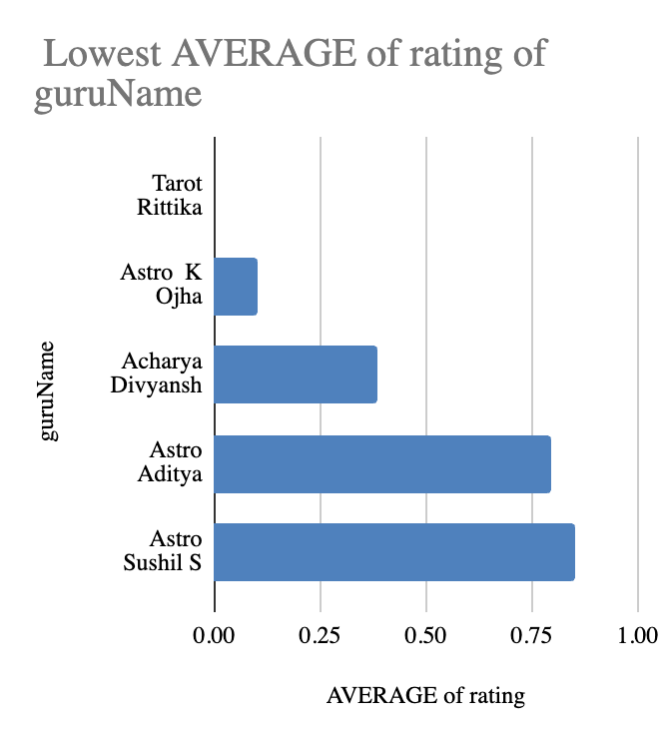
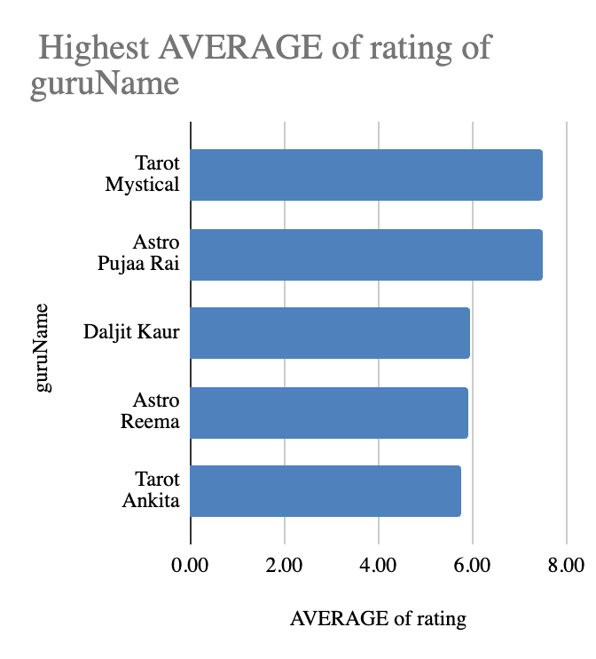
Performance Metrics-:
correlation between call duration and customer satisfaction
-0.0002024514064
Correlation Value: -0.0020
Insights:
Highest rating of guru:
•Tarot Mystical: 7.5
•Astro Pujaa Rai: 7.5
•Lowest rating guru:
•Tarot Rittika: 0
Key Metric:
•Average Calls per Agent per Day: 5.29 calls
Insights:
•On average, each agent handles 5.29 calls per day.

Slide 8
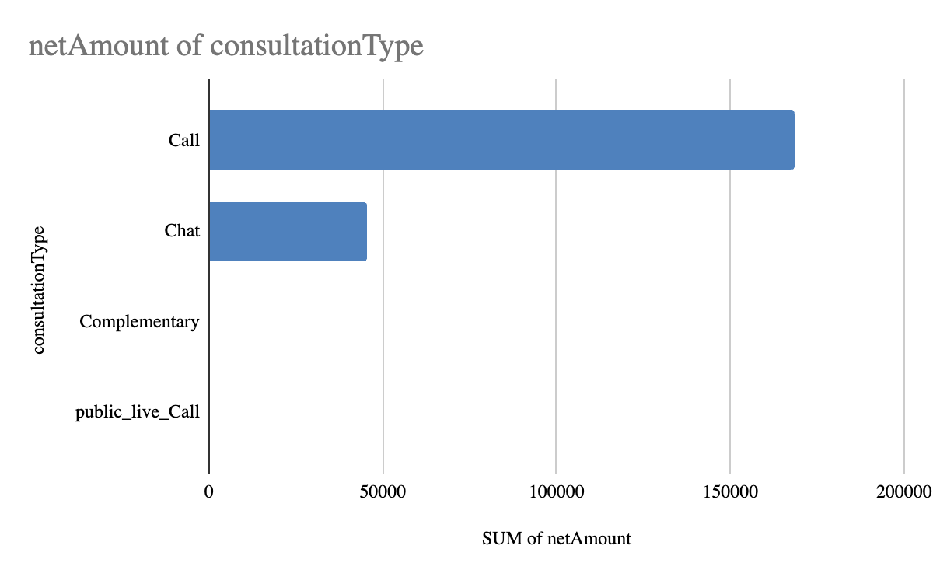
Customer and Product Analysis-:
repeat calls | total call | percentage of total repeat calls
4737 | 8365 | 56.63
Key Data:
•Total Sales Generated by Call Consultations: ₹168,442.04
•Total Sales by Chat Consultations: ₹45,494.68
•Total Sales by Public Live Calls: ₹50.60
•Grand Total Sales: ₹213,987.32
•A significant portion of the call center’s users, 56.63%, are repeat callers.

Slide 9
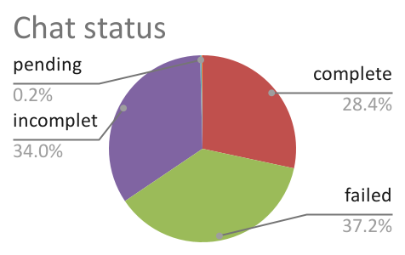
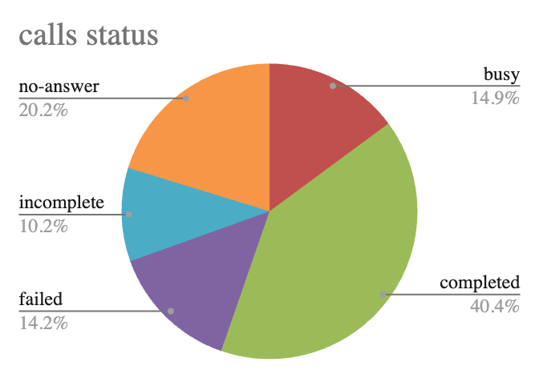
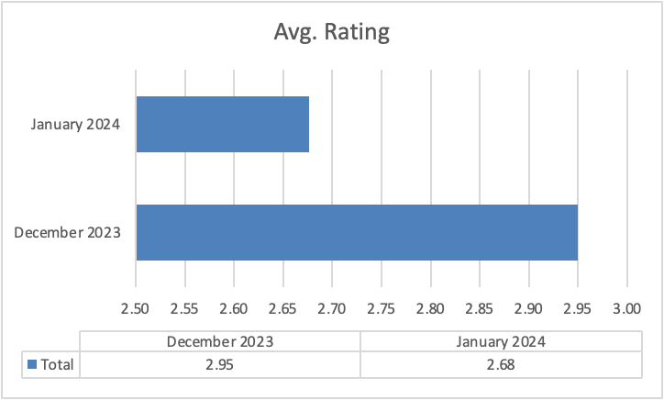
Impact of Call Duration on User Rating-:
Key Objective:
•Call Durations: Long chat and call durations are linked to lower satisfaction, indicating a need for process improvements.
•Agent Efficiency: Many agents handle fewer than 25 calls in their sessions, suggesting underutilization.
•The average earnings per astrologer are low (₹11 per session).
•High refund rates and failed calls suggest system inefficiencies that might require technology upgrades.
•Several astrologers consistently receive ratings lower than 5, indicating a need for training.
Avoid new hires unless there is a significant increase in call volume.

Slide 10
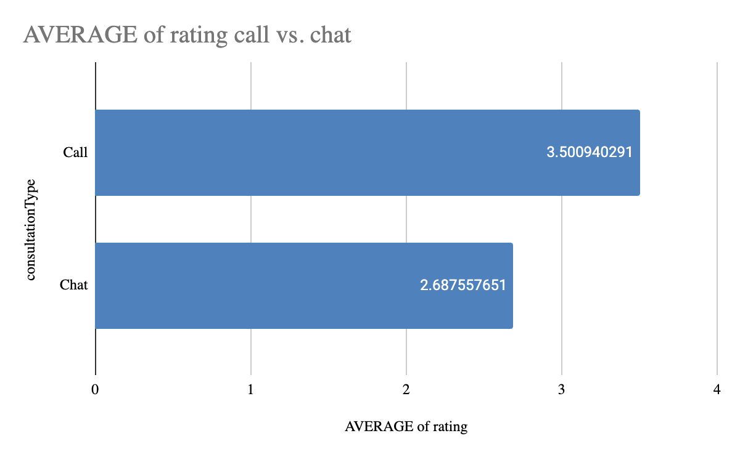
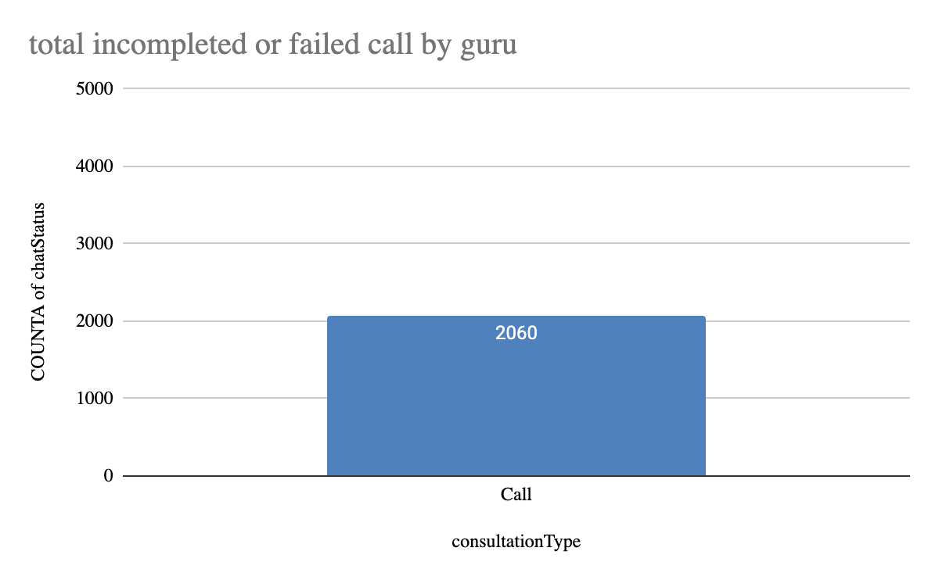
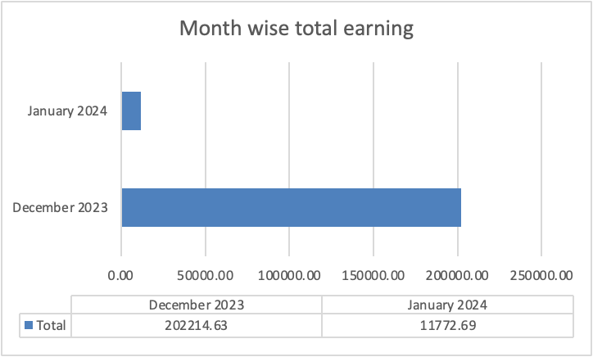
Astrologer Efficiency and Earnings-:
consultationType | SUM of netAmount
Call | 168442.035
Chat | 45494.68333
Complementary | 0
public_live_Call | 50.597
Grand Total | 213987.3153
correlation between call duration and customer satisfaction
-0.0002024514064

Slide 11
Dashboard-:

Slide 12
Recommendations:
Hiring & Training : Invest in hiring additional agents and providing training to improve agent performance and reduce workload.
Technology Upgrades : Implement AI chatbots to handle routine inquiries and predictive analytics to optimize agent allocation during peak times.
Customer Feedback & Monitoring Systems: Develop tools to capture real-time feedback and monitor agent performance, allowing for immediate interventions.
Operational Efficiency : Invest in optimizing call routing systems to ensure efficient use of agent time and reduce queue times.

Slide 13
Conclusion-:
Key Findings:
• Free chat sessions lead to higher operational costs and lower profitability.
• Shorter chat durations correlate with better user ratings.
• Astrologers’ efficiency can be improved with specialized training.
• Closing Statement:
• Strategic changes, such as optimizing free consultations and enhancing astrologer efficiency, will lead to improved profitability and user satisfaction.

